Slide 1
YORUBA DRUM LANGUAGE: AESTETHICS, CULTURAL RETENTIONS AND TRANSMISSIONS
BY
MOBOLANLE EBUNOLUWA SOTUNSA
BABCOCK UNIVERSITY, NIGERIA
VISITING SCHOLAR, AFRICAN STUDIES INSTITUTE
UNIVERSITY OF GEORGIA (UGA)
Delivered at African Studies Institute, University of Georgia on October 3, 2013

Slide 2
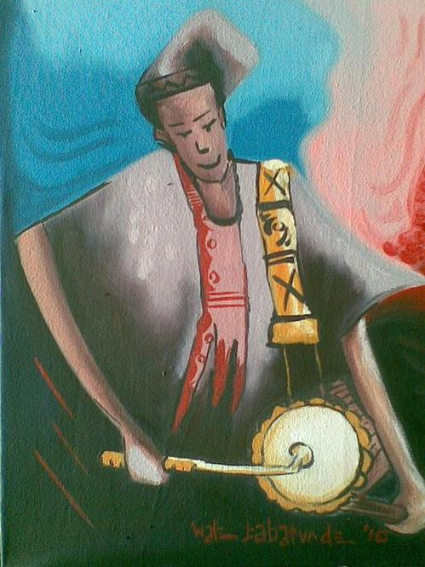

Slide 3
The Value of Yoruba Drum Poetry
Drum, dance and songs are at the heart of African artistic imagination, image making, creativity, inventiveness and socio- entertainment.
While the Yoruba talking drum is used for music making and entertainment, its significance goes beyond these functions.

Slide 4
Yoruba talking drum is used as a means of conveying messages. These messages are conveyed in diverse forms: as songs, rhymes, poems, proverbs, aphorisms, witty sayings and wise sayings. The Yoruba talking drum is an important instrument of history, philosophy, literature, poetry and music all put together

Slide 5
drum language is a surrogate language.
Drum language is a membrionic verbal communication
Of all the features of human language, it appropriates the tone and rhythm.
It transmits aural signals in form of drum sounds which are decoded by the trained ear as verbal language.
the tonal quality of Yoruba language and its vowel structure enables the drummer to recite poetry

Slide 6
The Aesthetics of Yoruba Drum Poetry
there are three fairly distinct forms in which literary material is employed.
used solo as an organ of direct speech
to imitate a singing voice
danceable rhythm

Slide 7
The talking drum brings out clearly lyricism or rhythm in human speech. The intonation of the talking drum is an elaborated version of the intonation of the ordinary speaking voice
Whenever the drum imitates the speech pattern, the consonants and vowels glide.
Drum speech mode is similar to the vocal-chant mode
In both cases, orthographic and lexico-semantic rules take new dimensions.

Slide 8
In drum texts, there is copious use of repetition to achieve musical effect.
In a characteristic short drum text, the first line is repeated twice and it also forms the closing line. This makes the line a form of refrain.
a consequent phrase is presented before its antecedent.

Slide 9
EXAMPLES
B’owo lu ni ko le pani (2ce)
Igi ti a fehin ti ti o gbani duro
Bowo luni kole pani
If it falls on one, it cannot kill one(2ce)
The tree one leans on that cannot bear one’s weight
If it falls on one, it cannot kill
(In context of betrayal, threats etc.)

Slide 10
EXAMPLES
Ma da girigiri bo mi (2ce)
Emi ki fi girigiri gesin baba mi
Ma da girigiri bo mi
don’t hasten me
I don’t ride my father’s horse in haste
don’t hasten me
(Response to someone hurrying up a drumming performance)

Slide 11
Piri l’olongo n ji(2ce)
Aki n ba okunrun eye lori ite
Piri l’olongo n ji
The waxbill wakes in fitness
We never find a sick bird in its nest
The waxbill wakes in fitness
(Early morning greetings)

Slide 12
The drum beats and other acrobatic displays of the drummer synchronize and enhance in no small measure the aesthetic quality of the entire performance.
The emotional excitement of both the drummer and the audience is consequently raised. The aesthetic pleasure, which the gestures and kinesis of the drummer arouse in the audience during performance sessions, is better experienced than explained.

Slide 13
Dancing goes hand in hand with drum poetry performance.
Very often drummers and dancers share a close affinity
A drummer encourages the dancer with his aggravated body movements.
“Dance is poetry in motion”.

Slide 15
the distinctive discourse of drum poetry forms part of its stylistic features.
By discourse, we mean a systematically organized mode of talking
Athough drum texts are often drawn from the traditional lore the talking drummer does not relay his messages in plain language

Slide 16
The discourse of drum poetry is not limited to verbal texts alone. It includes:
Verbal genres e.g. Oriki (Praise poetry), Owe (proverbs), Orin Ibile (folks song, poetry and rhymes)
Stylistic/aesthetic elements e.g. adunjoohun (onomatopoeia, rhythm for dance gestures);
Elements such as traditional history, current affairs; and the motivating factor in creativity that is afojuinuwo(imagination).

Slide 17
musical techniques of variation, repetition, truncation, elongation, tonal shift and improvisation are employed.
These techniques heighten the poetic effects and endow the poetry with musical qualities.

Slide 18
While drum lore draws from other vocal existing modes, it does so with a uniqueness of style and delivery not observed in the other modes, as such the art has earned much recognition and its continuous appeal to a wide range of audience is no suprise.

Slide 19
CULTURAL RETENTIONS
Because oral art forms are cultural systems giving form to fundamental expressions of individuals and societies, it has been recognized as a field of endeavour worthy of study, documentation and preservation.
Pioneer scholars include Ulli Beier, William Bascom, Ruth Finnegan, Oyin Ogunba, Olatunde Olatunji, Isidore Okpewho, Olajubu Oladare, and Akin Euba

Slide 20
CULTURAL RETENTIONS Ctd
Yoruba drum Poetry till date enjoys indigenous monopoly.
Yoruba Drum Poetry as a unique art has acquired a “mysterious” reputation among non Africans who marvel at the fact that the drum can talk, sing, recite stories and produce poetry which is discernable to the human ears, especially the drum literate individual.

Slide 21
CULTURAL RETENTIONS Ctd Traditional Uses
Traditional functions of the drummer include, announcing the arrival of important visitor(s)
recitation of oriki as the most important function.
for any art to thrive and enjoy fresh creativity, it must be dynamic and address itself to relevant challenges of the time.
drum poetry is capable of being evolved into a renowned global art.

Slide 22
Drumming occurs during religious festivals and secular ceremonies. Drumming is used on a daily basis in palaces, during coronations or chieftaincy awards, during marriage, naming, funerals, house warming ceremonies, among others.

Slide 23
CULTURAL RETENTIONS- Contemporary
In contemporary times, drum texts are used in popular music, the theatre, in written literatures in English, including poems and plays, in the media, in the advertisement industry, among other contemporary forms.

Slide 24
CULTURAL RETENTIONS Ctd
Yoruba media houses herald their news hour with drum beats. Oyo State (BCOS) heralds and closes its Yoruba news time with:
B’o ba ti ri ni e wi Say it just as it is
B’o ba ti ri ni e wi Say it just as it is
Ala kii b’omo leru A dream is never too
dreadful
Ko ma le e ro that a child cannot narrate it
B’o ba ti ri ni e wi Say it just as it is

Slide 25
CULTURAL RETENTIONS Ctd CONTEMPORARY- MEDIA
(BCOS) radio heralds its news time with:
Tati were ni t’ekute ‘le The house rat is alert
Asunparada ni ti’gi aja deep sleep is of the
roof
Abiamo ki i gb’ekun omo re a mother does not
hear her child cry
Ko ma tati were …. Without quick
alertness

Slide 26
CULTURAL RETENTIONS Ctd CONTEMPORARY- MEDIA
Radio Nigeria advertises itself through the drumbeats: This is Nigerian Broadcasting Station (2ce).
An interesting linguistic excursions
traditional rhythm is superimposed on the English language thereby imbuing the text with Yoruba tonal structure in contrast to its original English intonation pattern.

Slide 27
CULTURAL RETENTIONS Ctd CONTEMPORARY- POPULAR MUSIC
drum poetry and other indigenous idioms are integrated into Popular musician, art music and church music.
E. g Lagbaja:
O’muti gbagbe ise The drunkard forgets his sorrows
O d’akeregbe He covers his head with the palmwine
gourd
O d’akeregbe He covers his head with the the
palmwine gourd
O d’akeregbe bo’ri He covers his head with the palmwine
Gourd

Slide 28
CULTURAL RETENTIONS Ctd CONTEMPORARY- NOLLYWOOD
The film industry
Akinwunmi Isola’s Saworoide sub titled “The Parable of the Drum as the Voice of the People:

Slide 29
Bo ba se p’emi ni ‘wo n,i If I were you
ni ‘wo ni were you
N ba fa pa jo, fa pa jo, I would have danced with my hands
fa pa jo danced with my hands
Bo ba se pe mi ni wo ni , If I were you were
ni ‘wo ni were you
N ba f’ese jo, f’ese jo, I would have danced with my legs
F’ese jo have danced with my legs
Bo ba se pe mi ni wo ni , If I were you
N ba fi gbogbo ara jo I would have danced with my whole
body

Slide 30
TRANSMISSIONS
“Ohun a ni la n gbe laruge”- It is what we have that we treasure and promote
Yoruba drum poetry is a unique cultural asset, which must be further, explored, harnessed and exploited for the advancement of African cultures and indigenous technology in a global context.

Slide 31
TRANSMISSIONS: in diaspora
Yoruba as a diaspora are two categories :
the diaspora of slavery;
the contemporary diaspora in the age of globalization. (Migrants)
the diaspora of slavery created enduring legacies that survive to date (J
these legacies are being extended by the contemporary generation of Yoruba migrants.

Slide 32
The contemporary Yoruba abroad are transnationalists
who maintain contacts with the Yoruba at home.
The Yoruba diaspora has globalized Yoruba culture, and developed Yoruba consciousness.
(See Toyin Falola Atlantic Yoruba and the Expanding Frontiers of Yoruba Culture and Politics 2012

Slide 33
Regeneration is not just about affirming past heritage, but also about new inventions and creativities.
The Yoruba in the diaspora have redefined and expanded the boundaries of Yorubaness. In taking Sango and Ogun abroad, they globalized the gods.

Slide 35
In the same manner Drum language should be internationalized
Efforts in this direction should be more concerted.
(E.g Independence Day, )
SHOW CLIPSES
http://www.youtube.com/watch?feature=player_embedded&v=JZ-CsdtbdZE

Slide 36
In the same manner Drum language should be internationalized
Efforts in this direction should be more concerted.
(E.g Independence Day, )
SHOW CLIPSES
http://www.youtube.com/watch?feature=player_embedded&v=JZ-CsdtbdZE

Slide 37
http://www.youtube.com/watch?feature=player_embedded&v=JZ-CsdtbdZE#t=105

Slide 38
Egbe Omo Yoruba- National Association of Yoruba Descendants in North America
Chapter in Atlanta, New York, Houston Texas, Baltimore, Maryland, Washington DC

Slide 39
CLOSING REMARKS
MY RESERCH AT AFRICAN STUDIES INSTITUTE, UNIVERSITY OF GEORGIA ATHENS TITLED A COMPENDIUM OF SHORT YORUBA DRUM TEXT IS AN EFFORT IN PROVIDING RESOURCES FOR GREATER TRANSMISSIONS OF YORUBA DRUM LANGUAGE

Slide 40
E je ka re le
Ile la n lo
Agbe kan o r’oko, r’oko
Ko gba gbe ile
Let us go home
It is home we are heading to
No farmer goes to the farmstead
And forgets his home

Slide 41
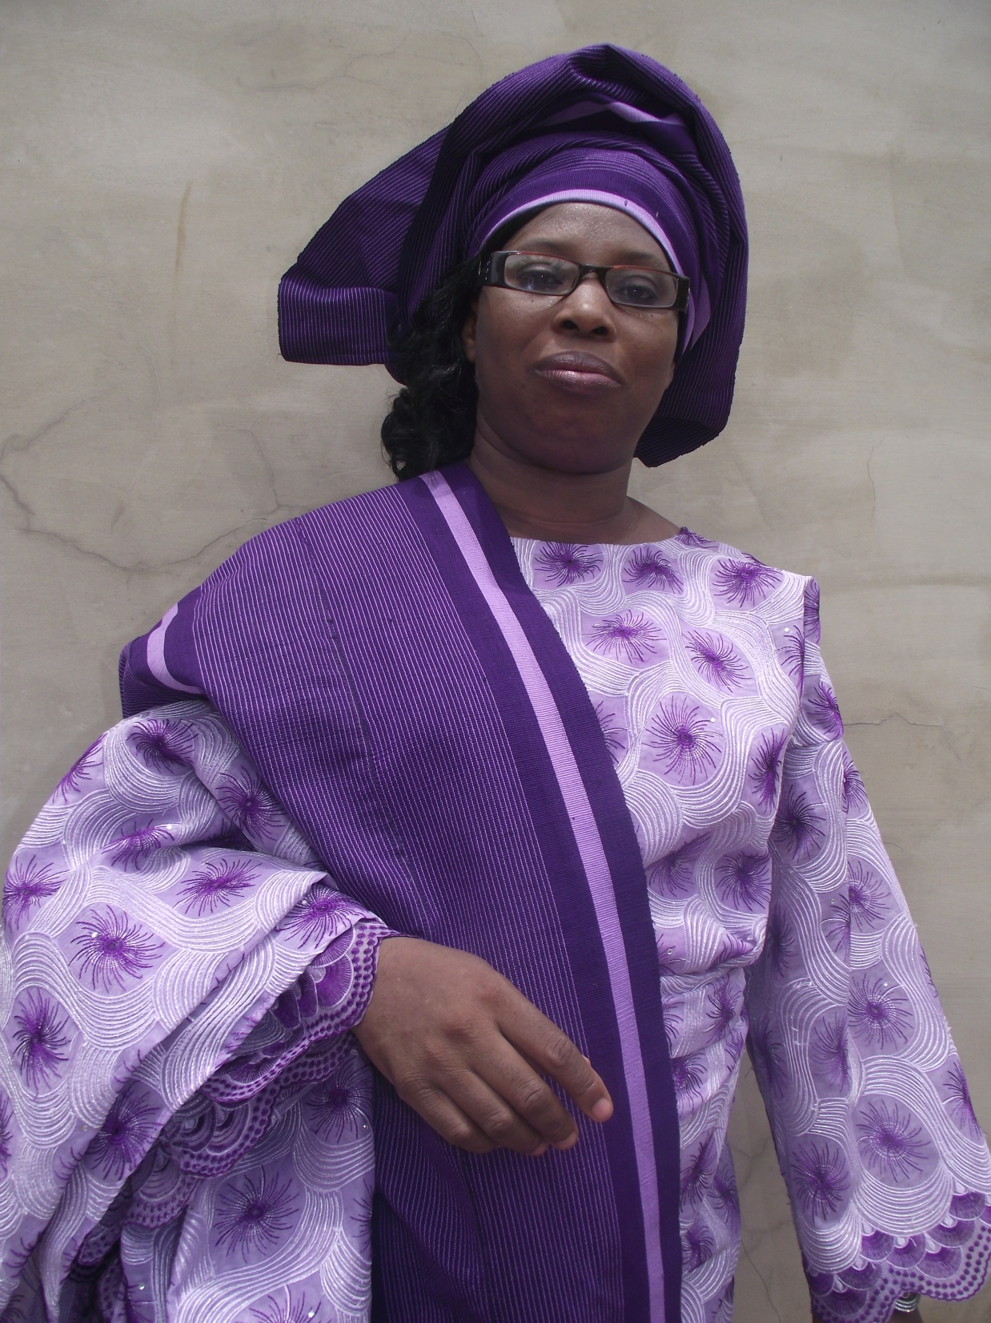
Thank you for listening

